Slide 1
Convolutional Neural Networks: Applications, Security and Ethics
Grand Canyon University
Swathi Chidurala
Notes:
Title of the PowerPoint Presentation

Slide 2
Introduction
Objectives
Introduce CNNs and their applications, and explore security and ethical issues.
Agenda
Basic Concepts of CNNs
Security Issues in CNNs
Ethical Considerations in CNN Applications

Slide 3
Basic concepts of CNNs
Definition: Convolutional Neural Networks (CNNs) are a class of deep neural networks primarily used for analyzing visual imagery.
Key Components:
Convolutional Layers: Extract features from input images.
Pooling Layers: Reduce the dimensionality of feature maps.
Fully Connected Layers: Perform classification based on extracted features.
Commonly Used Libraries: TensorFlow, Keras, PyTorch
Notes:
Convolutional Neural Networks (CNNs) are a class of deep neural networks primarily used for analyzing visual imagery. They are designed to automatically and adaptively learn spatial hierarchies of features from input images through the use of convolutional layers.
Key Components:
Convolutional Layers: These layers are responsible for extracting features from input images. They apply a set of filters (kernels) to the input image to produce feature maps, highlighting different aspects of the image such as edges, textures, and patterns.
Pooling Layers: These layers reduce the dimensionality of feature maps while retaining important information. This is done by summarizing the presence of features in certain regions of the image, which helps to make the network more robust to variations and reduces computational complexity.
Fully Connected Layers: After convolutional and pooling layers have extracted and condensed features from the image, fully connected layers are used to perform classification. They take the high-level filtered images and map them to the output classes.
Commonly Used Libraries: TensorFlow, Keras, and PyTorch are the most commonly used libraries for implementing CNNs. These libraries provide extensive tools and pre-built functions that simplify the process of building, training, and deploying CNN models.

Slide 4
Types of Datasets
Image Net: A large dataset for visual object recognition.
MNIST: A dataset of handwritten digits.
CIFAR10 dataset: A dataset of small images in 10 different classes.
Applications:
Facial recognition
Automated driving systems
Handwriting recognition
Notes:
Explanations
ImageNet:
Explanation: ImageNet is a large-scale dataset designed for visual object recognition software research. It contains millions of images categorized into thousands of classes.
Reference: Deng, J., Dong, W., Socher, R., Li, L.-J., Li, K., & Fei-Fei, L. (2009). ImageNet: A large-scale hierarchical image database. 2009 IEEE Conference on Computer Vision and Pattern Recognition. Retrieved from https://www.image-net.org
MNIST:
Explanation: MNIST (Modified National Institute of Standards and Technology) is a dataset of 70,000 handwritten digits, widely used for training and testing image processing systems. It includes images of digits from 0 to 9.
Reference: LeCun, Y., Cortes, C., & Burges, C. J. C. (2010). MNIST handwritten digit database. Retrieved from http://yann.lecun.com/exdb/mnist/
CIFAR-10:
Explanation: The CIFAR-10 dataset consists of 60,000 32x32 color images in 10 different classes, with 6,000 images per class. It is commonly used for training machine learning and computer vision algorithms.
Reference: Krizhevsky, A., & Hinton, G. (2009). Learning multiple layers of features from tiny images. University of Toronto. Retrieved from https://www.cs.toronto.edu/~kriz/cifar.html

Slide 5
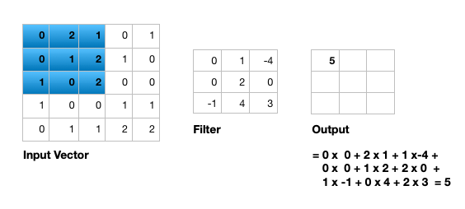
Convolutional Layers
Explanation: Convolutional layers apply filters to the input image to create feature maps.
Function: Detect edges, textures, shapes, and other visual patterns.
Notes:
Convolutional Layers
Explanation: Convolutional layers are the core building blocks of a CNN. They consist of a set of learnable filters (or kernels), which slide over the input image to produce a set of feature maps. Each filter is capable of detecting different types of features such as edges, textures, and patterns at various locations in the image.
Function: The main function of convolutional layers is to detect and extract various features from the input image. As the layers go deeper, they capture more complex patterns and structures. For example, the initial layers might detect edges and simple shapes, while deeper layers can detect more complex structures like parts of objects or entire objects.
Visual: A diagram of the convolutional layer operation typically includes:
An input image
A filter (or kernel) sliding over the image
Resulting feature maps

Slide 6
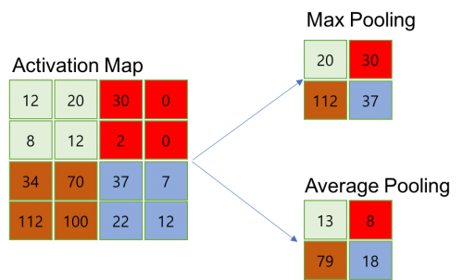
Pooling Layers
Explanation:
Pooling layers reduce the spatial dimensions of the feature maps.
Types Of Pooling:
Max pooling, Average pooling
Notes:
Pooling Layers
Explanation: Pooling layers, also known as subsampling or downsampling layers, are used to reduce the spatial dimensions of the feature maps produced by convolutional layers. This reduction helps to decrease the computational load and the number of parameters in the network, which can help prevent overfitting.
Types:
Max Pooling: This type of pooling selects the maximum value from each window of the feature map, which helps to retain the most prominent features.
Average Pooling: This type of pooling calculates the average value within each window of the feature map, which provides a more generalized representation of the features.
Visual: A diagram showing max pooling operation typically includes:
A feature map divided into regions (windows)
The maximum value being selected from each region
The resulting reduced feature map

Slide 7
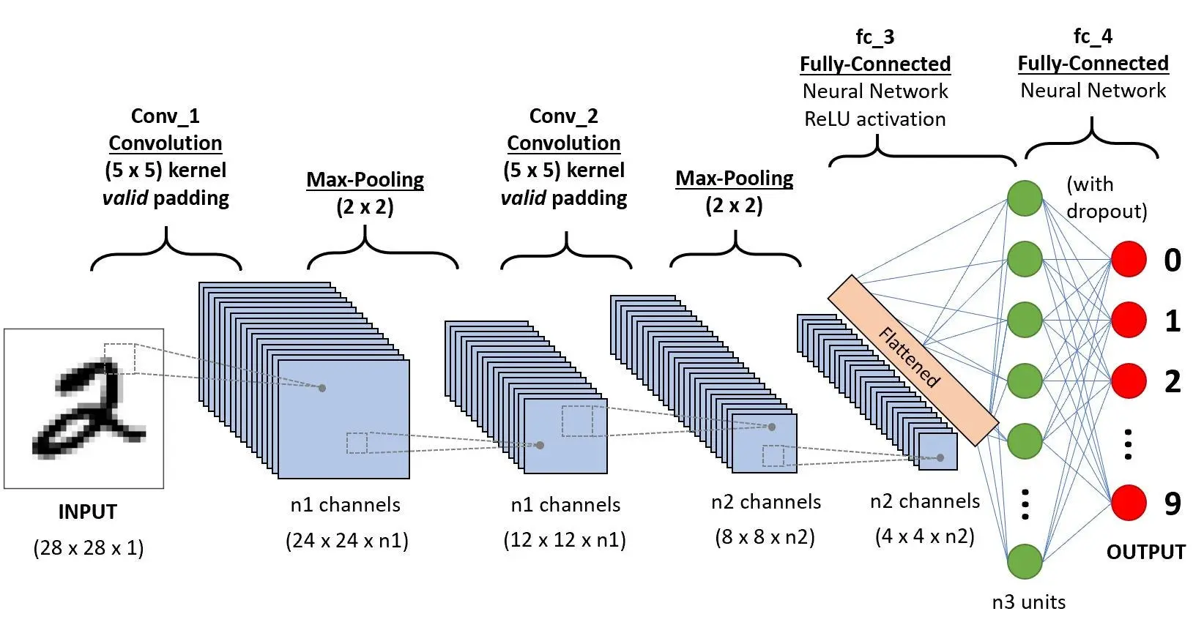
CNN Architecture

Slide 8
Security issues in CNN
Adversarial Attacks:
Definition: Small, intentional perturbations to input images that fool CNN into making incorrect predictions.
Example: A stop sign altered to be misclassified by an autonomous car.
Model Theft:
Definition: Unauthorized replication of a model by querying it and analyzing outputs.
Example: Stealing a proprietary facial recognition model.
Notes:
Adversarial Attacks
Definition: Adversarial attacks are a type of security threat where small, intentional perturbations are added to input images to deceive a Convolutional Neural Network (CNN) into making incorrect predictions. These perturbations are often imperceptible to the human eye but can cause a well-trained CNN to misclassify the altered images.
Szegedy, C., Zaremba, W., Sutskever, I., Bruna, J., Erhan, D., Goodfellow, I., & Fergus, R. (2013). Intriguing properties of neural networks. arXiv preprint arXiv:1312.6199. Retrieved from https://arxiv.org/abs/1312.6199

Slide 9
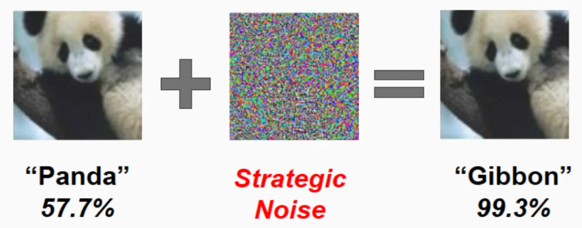

Security Issues: Supporting Examples
Adversarial Attack Example
Attack on Image Classification: An image of a panda correctly classified by a CNN is subtly modified. The modified image, almost indistinguishable to the human eye, is misclassified as a gibbon.
Attack on Autonomous Vehicles: Stop signs are altered with stickers to be misinterpreted as speed limit signs, potentially causing dangerous driving decisions by autonomous vehicles.
Notes:
Explanation:
Mechanism: Adversarial attacks exploit the way CNNs learn and process input data. By carefully crafting perturbations, attackers can manipulate the input image to move it into a different region of the feature space, leading to incorrect classification.
Impact: These attacks can have serious consequences, especially in critical applications like autonomous driving, security systems, and medical diagnostics. For instance, if an adversarial attack causes an autonomous vehicle to misinterpret a stop sign as a speed limit sign, it could lead to dangerous driving behavior and potential accidents.
Real-world Example: Researchers have demonstrated that by adding stickers or subtle modifications to stop signs, they can cause an autonomous vehicle's CNN to misclassify the sign as a different traffic signal. This type of attack highlights the vulnerability of CNNs to adversarial manipulation and the need for robust defenses against such threats.
Example:
A stop sign altered with strategically placed stickers or graffiti to be misclassified by an autonomous car’s CNN. The original stop sign would be correctly recognized, but the altered version could be misinterpreted as a different traffic sign, leading to potentially hazardous situations
Stewart, M. (2019, April 23). Security Vulnerabilities of Neural Networks. Towards Data Science. Retrieved from https://towardsdatascience.com/hacking-neural-networks-2b9f461ffe0b

Slide 10

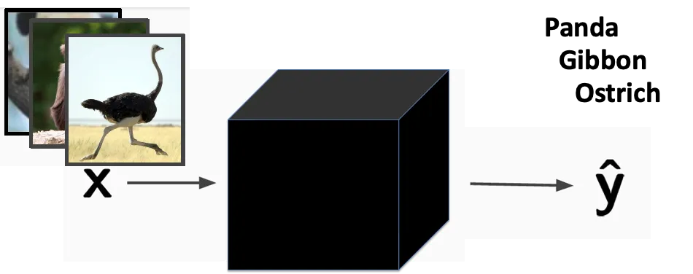
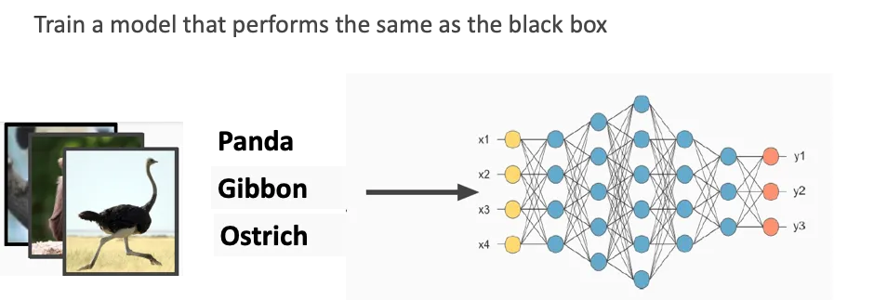
Security Issues: Supporting Examples
Model Theft Example
Attack on Commercial APIs: By repeatedly querying a commercial image classification API with carefully chosen inputs, an attacker can reconstruct a model that performs similarly to the original, effectively stealing its functionality without access to the training data.
Attack on Voice Recognition Systems: Attackers replicate the functionality of a proprietary voice recognition model by recording outputs for various inputs, then using this data to train a similar model.
Notes:
Model Theft
Definition: Model theft, also known as model extraction or model inversion, involves the unauthorized replication of a machine learning model. Attackers achieve this by repeatedly querying the model and analyzing the outputs to reconstruct a similar model that mimics the original's functionality.
Explanation:
Mechanism: In a model theft attack, the adversary sends numerous input queries to the target model (often accessible via an API) and collects the corresponding outputs. By analyzing these input-output pairs, the attacker can train their model to approximate the behavior of the original model without having direct access to the proprietary model or its training data.
Impact: Model theft can lead to significant intellectual property loss and competitive disadvantages for companies that invest heavily in developing unique machine learning models. Additionally, stolen models can be used for malicious purposes, bypassing security measures, or violating user privacy.
Real-world Example: Attackers can target commercial facial recognition APIs by submitting a diverse set of face images and capturing the returned labels or confidence scores. With enough data, they can train their own model to replicate the functionality of the proprietary facial recognition system, effectively stealing the model.
Example:
Stealing a proprietary facial recognition model by repeatedly querying the API with various face images and recording the results. This allows the attacker to reconstruct a model that performs similarly to the original, compromising the proprietary model's security and commercial value.
Stewart, M. (2019, April 23). Security Vulnerabilities of Neural Networks. Towards Data Science. Retrieved from https://towardsdatascience.com/hacking-neural-networks-2b9f461ffe0b

Slide 11
Ethical Issues in CNN Applications
Privacy Concerns:
Issue: Unauthorized surveillance and data collection using facial recognition systems.
Impact: Invasion of privacy and potential misuse of data.
Bias and Discrimination:
Issue: CNNs trained on biased datasets can reinforce and amplify biases.
Impact: Discriminatory practices in hiring, law enforcement, etc.
Notes:
Ethical Issues in Computer Vision and Strategies for Success. (n.d.). Retrieved from https://innodata.com/ethical-issues-in-computer-vision-and-strategies-for-success/

Slide 12
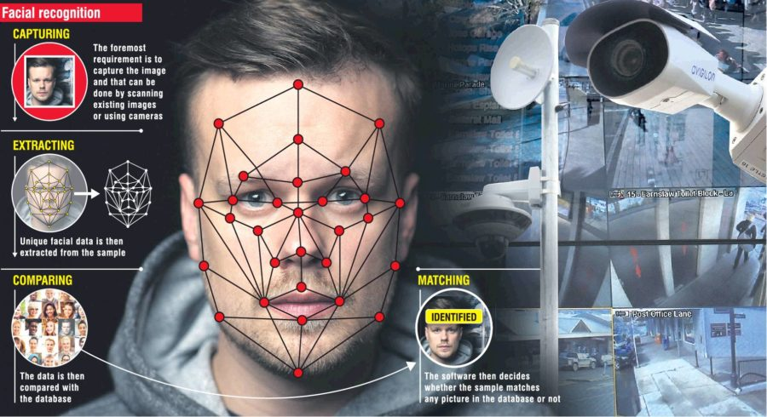
Ethical Issues: Supporting Examples
Privacy Concern Example:
Surveillance and Facial Recognition: The use of facial recognition technology in public and private spaces can lead to unauthorized surveillance, tracking individuals without their consent, and invasion of privacy.
Example from Source: Use of AI in surveillance cameras to monitor public spaces can lead to privacy violations and misuse of data.
Bias and Discrimination Example
Bias in Gender Classification: CNNs trained on biased datasets can produce discriminatory results, particularly in gender classification systems that perform poorly on women of color compared to white men.
Example from Source: AI systems used in hiring processes may exhibit bias, leading to unfair treatment of candidates based on gender or ethnicity.
Notes:
Crawford, K., & Paglen, T. (2019). Excavating AI: The politics of images in machine learning training sets. Retrieved from https://excavating.ai/
Buolamwini, J., & Gebru, T. (2018). Gender shades: Intersectional accuracy disparities in commercial gender classification. Proceedings of the 1st Conference on Fairness, Accountability and Transparency, 81, 77-91. Retrieved from http://proceedings.mlr.press/v81/buolamwini18a/buolamwini18a.pdf

Slide 13
Ethical Issues and Christian Worldview
Privacy:
Christian Perspective: Emphasizes the importance of respecting individual dignity and privacy.
Impact: Violations can lead to loss of trust and harm to individuals' well-being.
Bias and Discrimination:
Christian Perspective: Advocates for fairness, justice, and equality.
Impact: Biased AI systems can perpetuate injustice and inequality.
Notes:
Johnson, M. (2019). Artificial intelligence and the Christian faith: An exploration of moral implications. Journal of Christian Ethics, 23(2), 45-58.

Slide 14
Conclusion
Summary: We covered the basics of CNNs, including their key components and common datasets like ImageNet, MNIST, and CIFAR-10. We also discussed security issues such as adversarial attacks and model theft and ethical concerns like privacy and bias.
Final Thought: Responsible AI development and usage are crucial to ensure that AI technologies benefit society and maintain public trust.
Call to Action: Continue learning about AI advancements and adopt ethical practices to build secure and fair AI models.

Slide 15
References
Buolamwini, J., & Gebru, T. (2018). Gender shades: Intersectional accuracy disparities in commercial gender classification. Proceedings of the 1st Conference on Fairness, Accountability and Transparency, 81, 77-91. Retrieved from http://proceedings.mlr.press/v81/buolamwini18a/buolamwini18a.pdf
Crawford, K., & Paglen, T. (2019). Excavating AI: The politics of images in machine learning training sets. Retrieved from https://excavating.ai/
Ethical Issues in Computer Vision and Strategies for Success. (n.d.). Retrieved from https://innodata.com/ethical-issues-in-computer-vision-and-strategies-for-success/
Johnson, M. (2019). Artificial intelligence and the Christian faith: An exploration of moral implications. Journal of Christian Ethics, 23(2), 45-58.
Stewart, M. (2019, April 23). Security Vulnerabilities of Neural Networks. Towards Data Science. Retrieved from https://towardsdatascience.com/hacking-neural-networks-2b9f461ffe0b
Szegedy, C., Zaremba, W., Sutskever, I., Bruna, J., Erhan, D., Goodfellow, I., & Fergus, R. (2013). Intriguing properties of neural networks. arXiv preprint arXiv:1312.6199. Retrieved from https://arxiv.org/abs/1312.6199
Tramer, F., Zhang, F., Juels, A., Reiter, M. K., & Ristenpart, T. (2016). Stealing Machine Learning Models via Prediction APIs. Proceedings of the 25th USENIX Security Symposium (USENIX Security 16), 601-618. Retrieved from https://www.usenix.org/conference/usenixsecurity16/technical-sessions/presentation/tramer
Notes:
APA style references for the sources used in the PowerPoint.

Slide 16
Recording Link
https://vimeo.com/953606682/6bbdd2d681?share=copy

